Slide 1
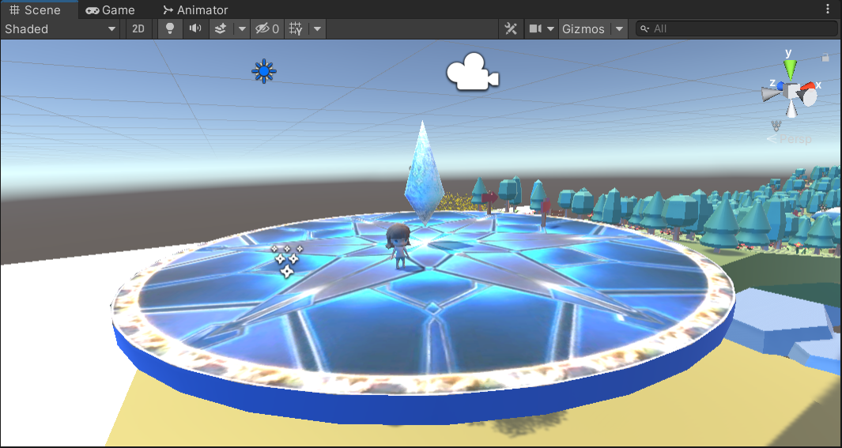

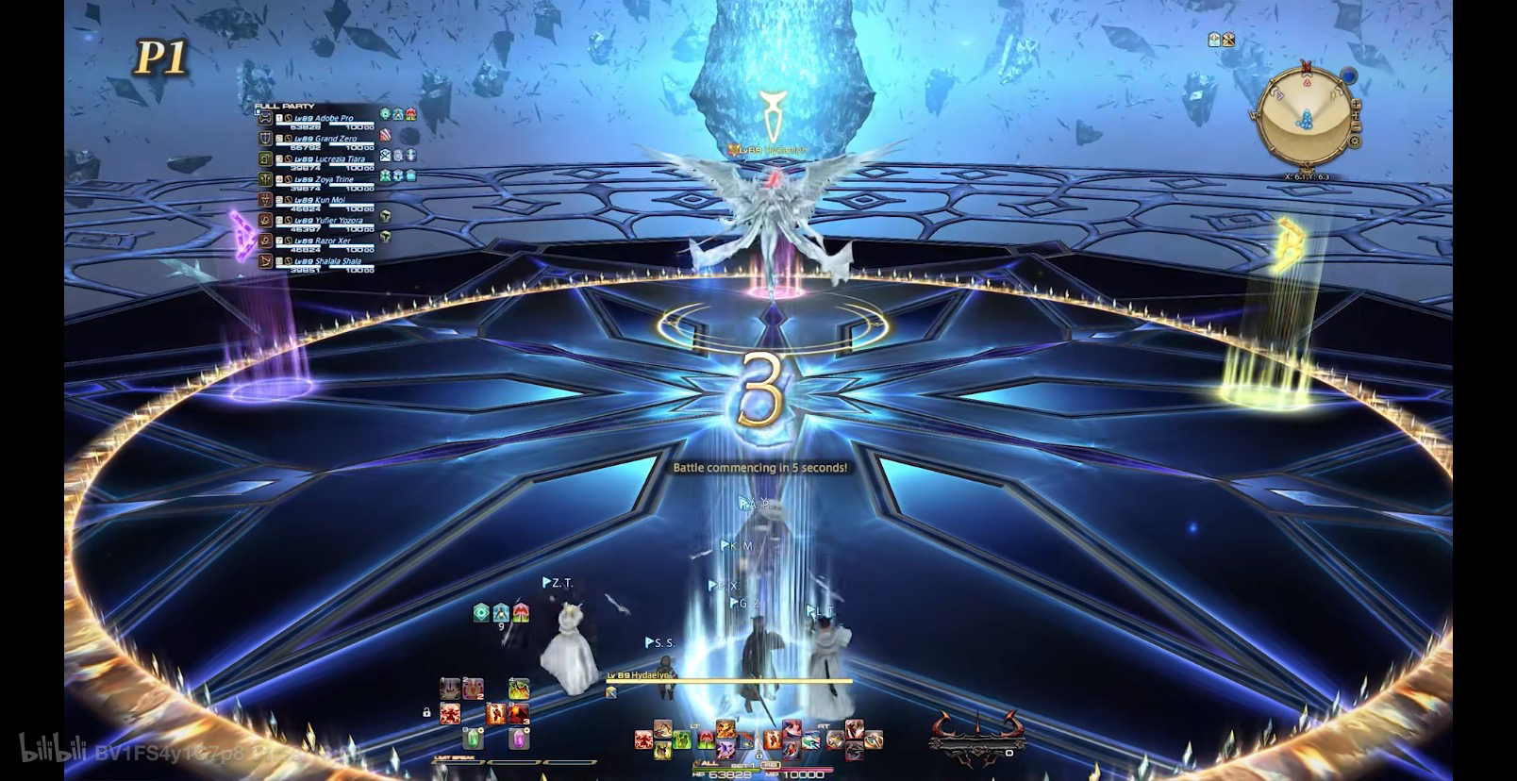
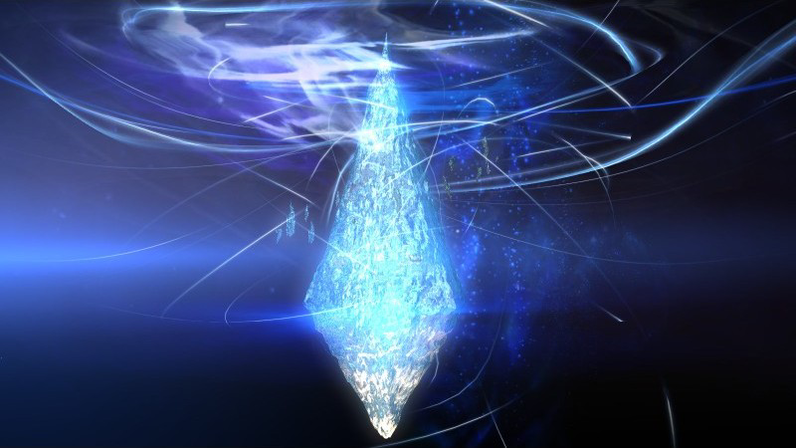
Initial location: Eorzea
Hydaelyn, also referred to simply as the Crystal or the Mothercrystal due to her association with it as its keeper, is a central character in Final Fantasy XIV. She shares her name with the world where the game takes place, which she had created. Initially speaking through the Mothercrystal, she guides the Warrior of Light and the Scions of the Seventh Dawn on their quest against the Ascians' machinations. She will also guide the player to set off a new adventure in the game.
Hear...feel...think...

Slide 2
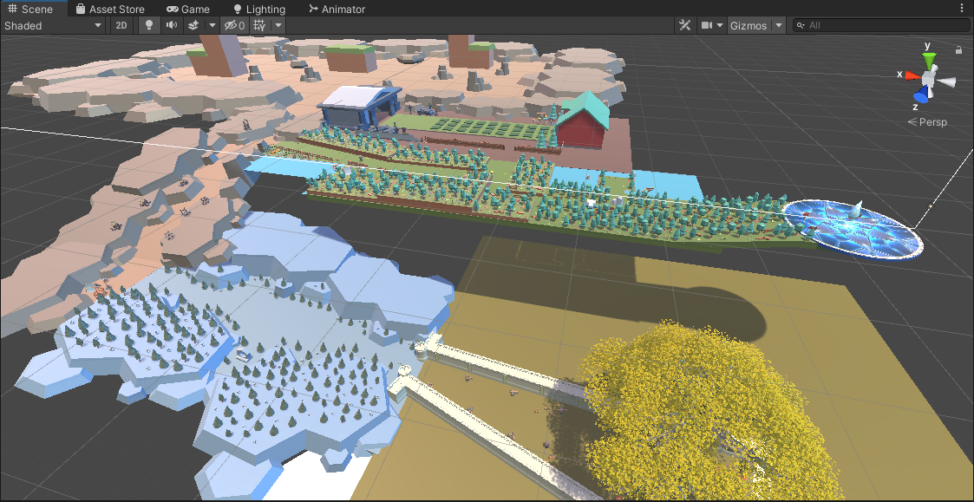
Scene

Slide 3
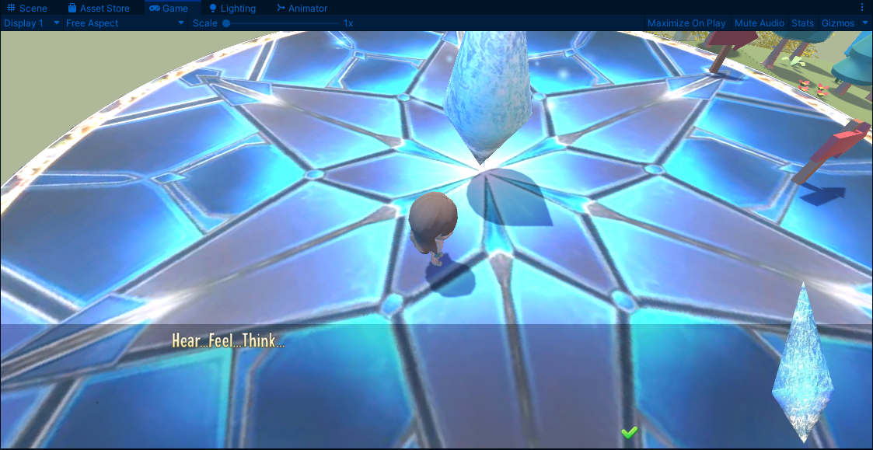
Dialog

Slide 4
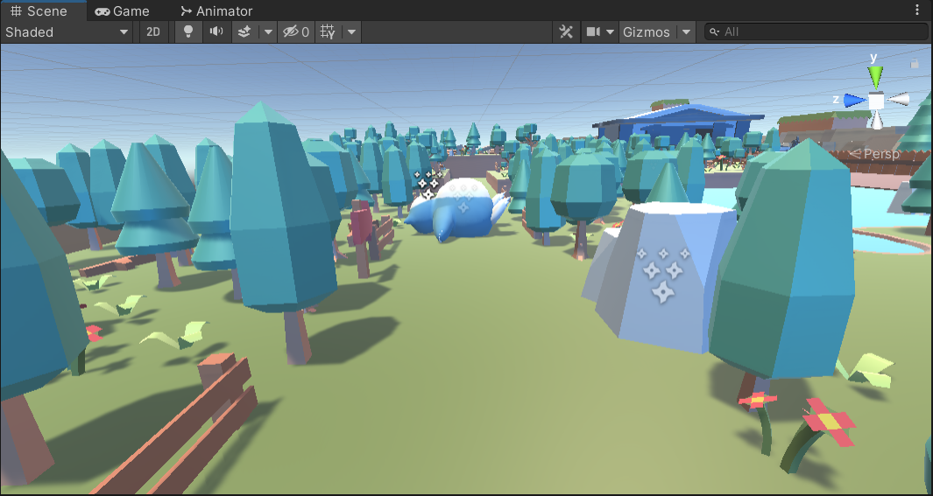
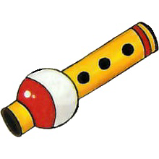
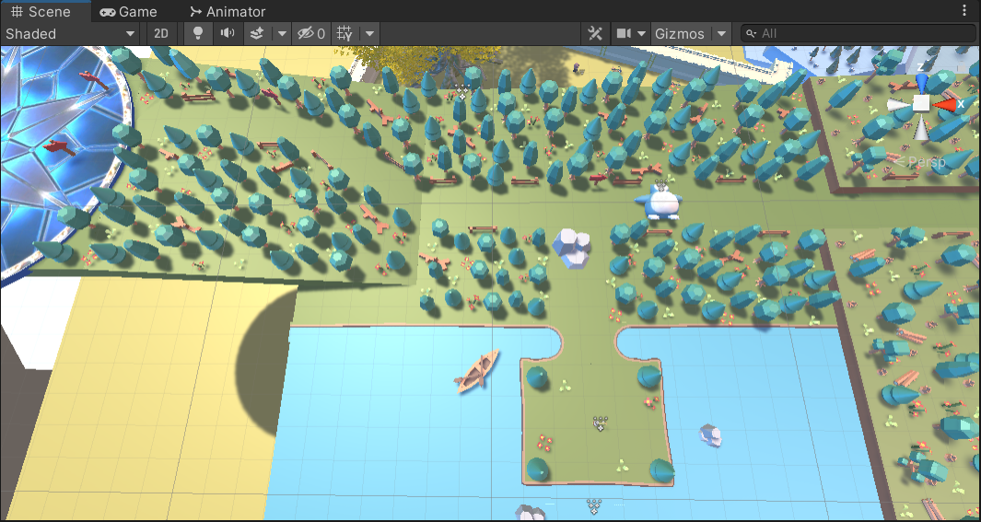
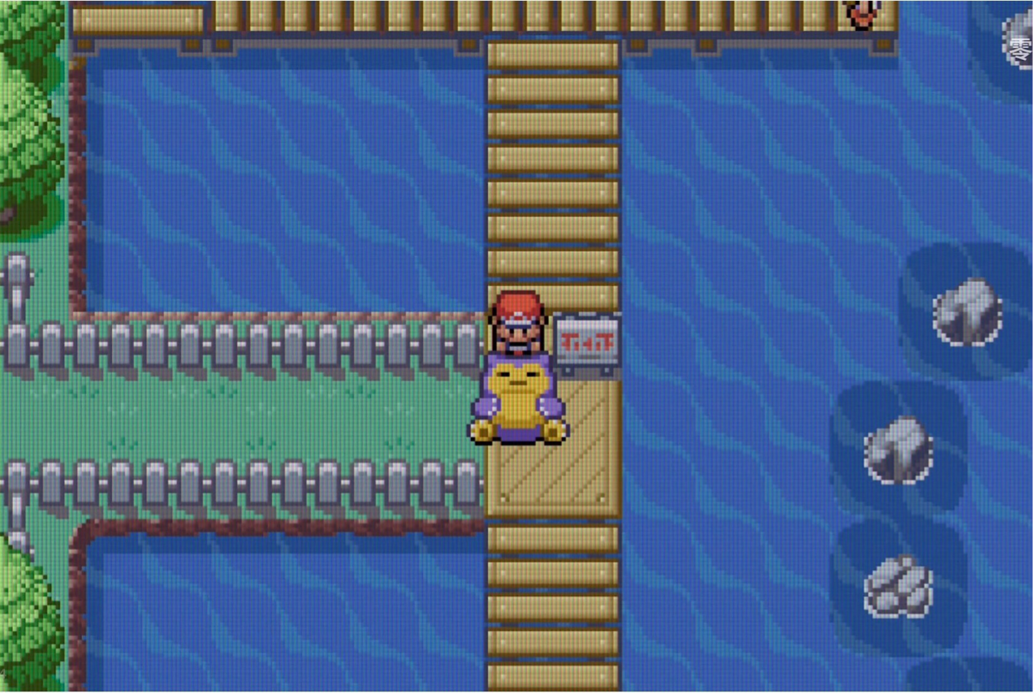

Location1: Route 12
Since the third generation of Pokemon, the Pokemon flute has been used to wake up the sleeping Snorlax in the way. After the player interacts with the Snorlax three times, the rocks in the way will break and open a path. Players can get Pokemon flute from it and continue to move forward.
⇩

Slide 5
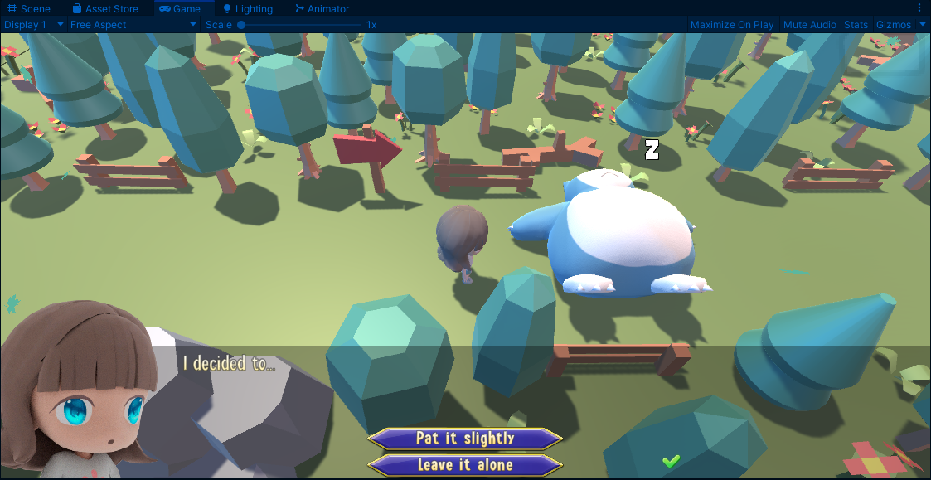
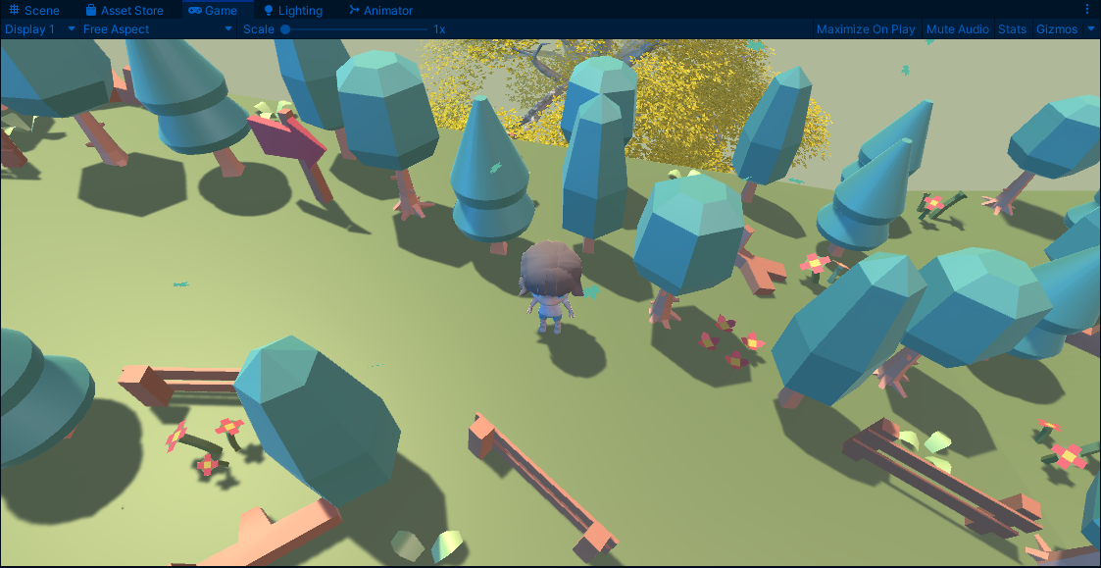
Location 1 real gameplay screens

Slide 6

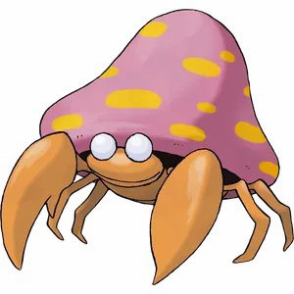
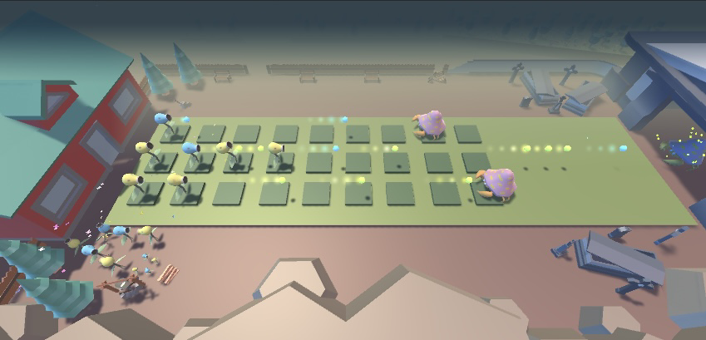
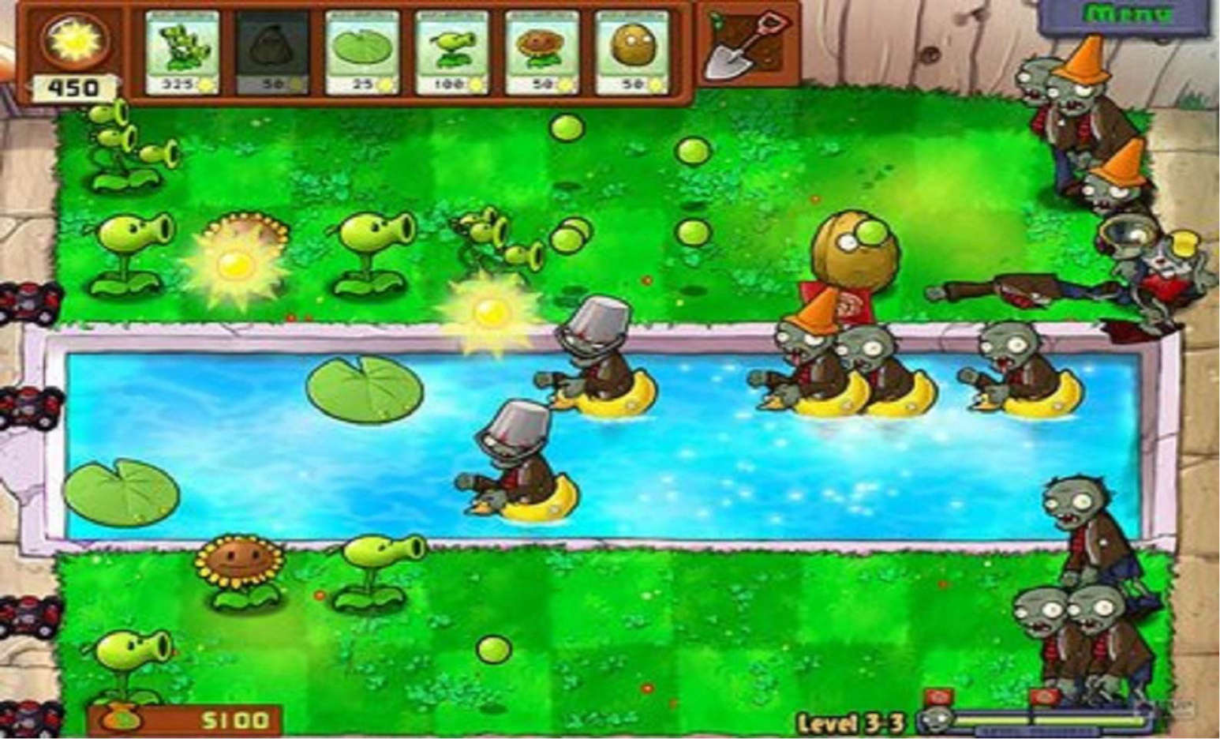

Location: David's Pokémon’s backyard
Pokédex entries
Yellow: The bug host is drained of energy by the mushrooms on its back. They appear to do all the thinking.
Pearl: It is controlled by a mushroom grown larger than the bug body. It is said to prefer damp places.
Ultra Sun：The bug is mostly dead, with the mushroom on its back having become the main body. If the mushroom comes off, the bug stops moving.
Legends: Arceus：Mushroom-lacking specimens of this Pokémon lie unmoving in the forest, lending credence to the hypothesis that the large mushroom is in control of Parasect's actions.
Taking "Plants vs Zombies" as a reference, the shape of the Bellsprout is similar to that of the pea shooter. However, due to being parasitized by mushrooms on the back, the tmushroom controls the body of Parasect, and the setting is similar to a zombie. So they were used instead of pea shooters and zombies.
Sothis is a character from Fire Emblem: Three Houses and Fire Emblem Warriors: Three Hopes. She can speak directly to the player telepathically, and also grants the player the usage of her time manipulation power which she calls Divine Pulse. After the game fails, Sothis will also appear to help the player restart the game.

Slide 7
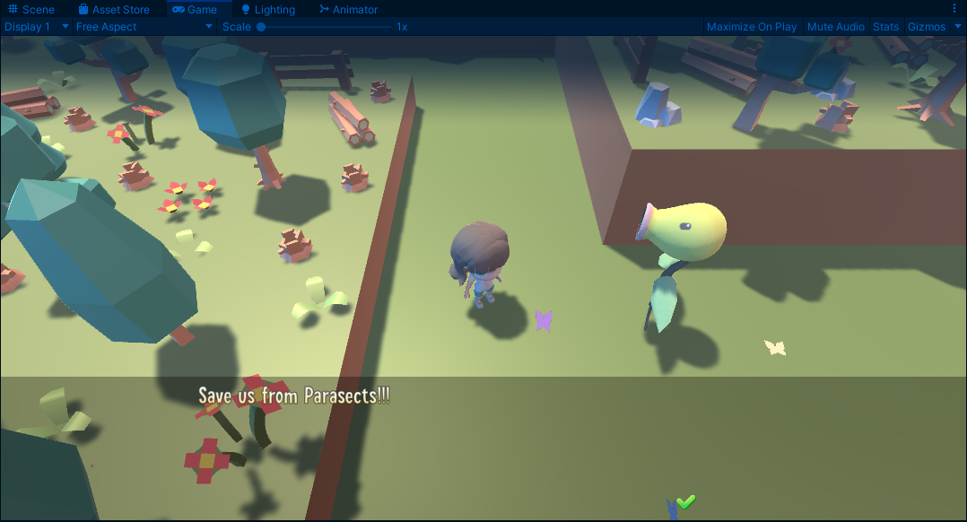
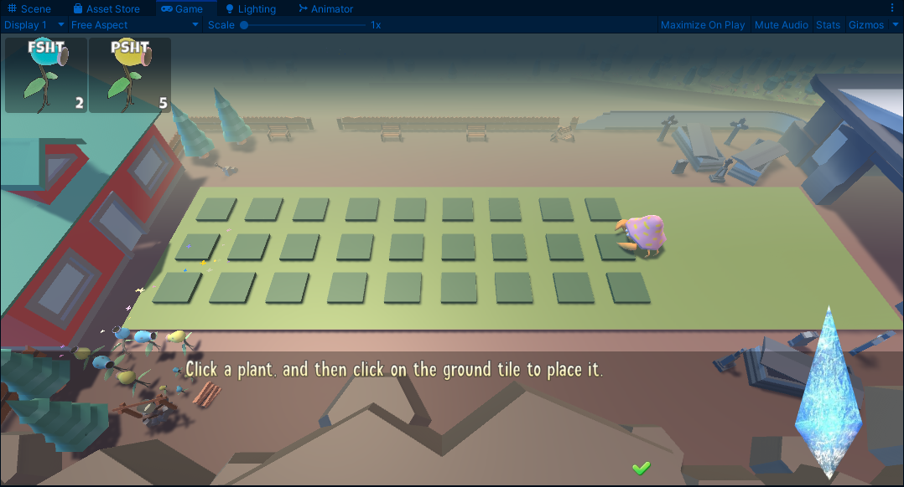
Location 2 real gameplay screens

Slide 8
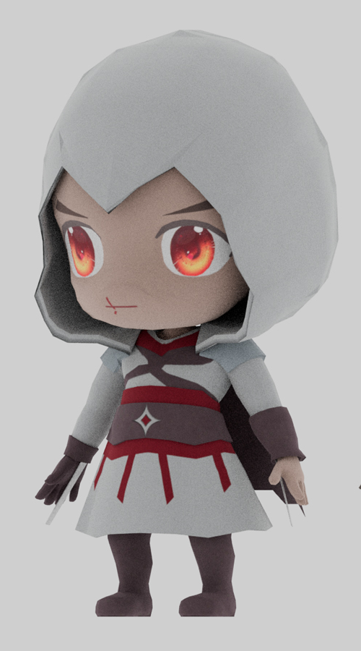
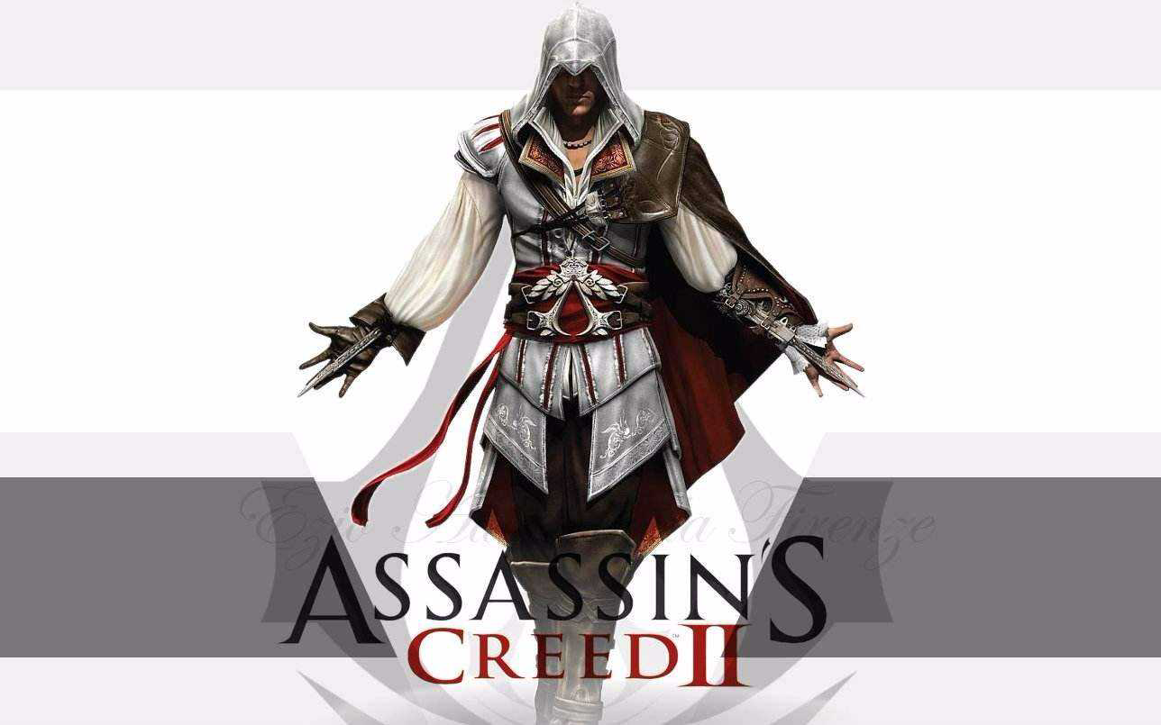
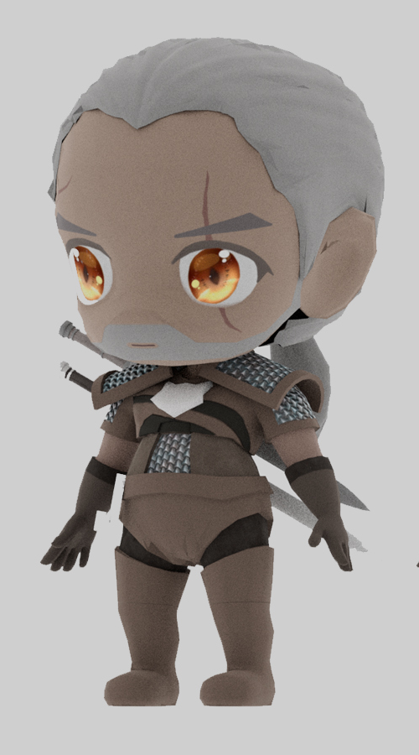
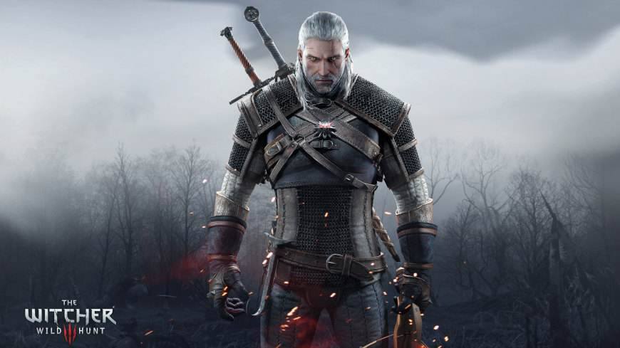
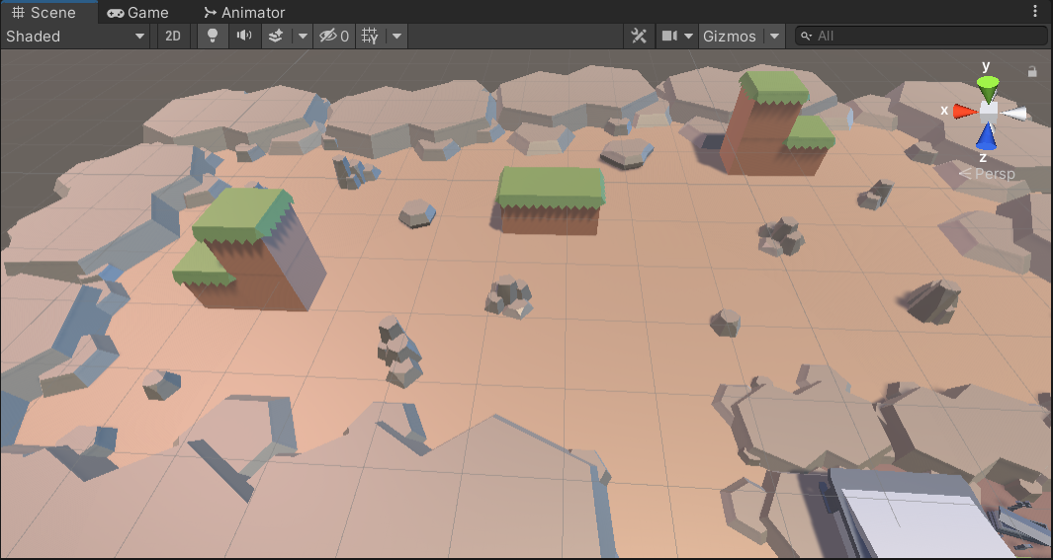
Location: Velen
In Assassin's Creed , assassins are very good at the "leap of faith" from a high place. In the wizard3: wild hunt, a few steps can kill a wizard. So I invited Ezio and Geralt to have a jumping race. In the first match, Geralt standed higher than Ezio. In the second match, the two men are equal in height. In the third match, Ezio standed higher than Geralt. But Geralt will undoubtedly lose the game.

Slide 9
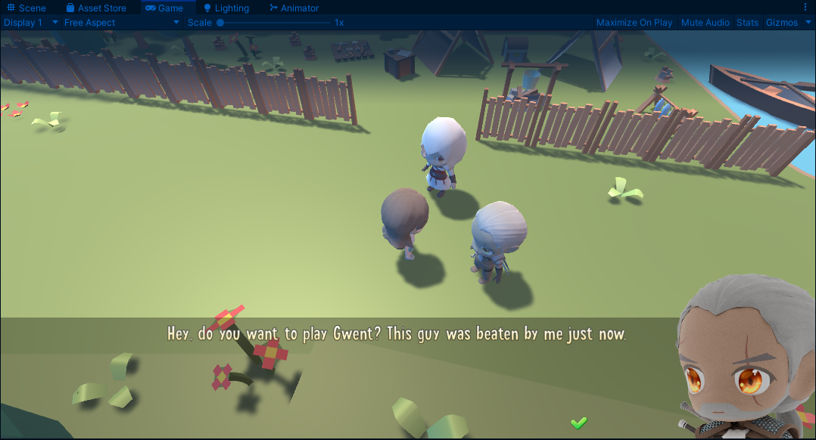
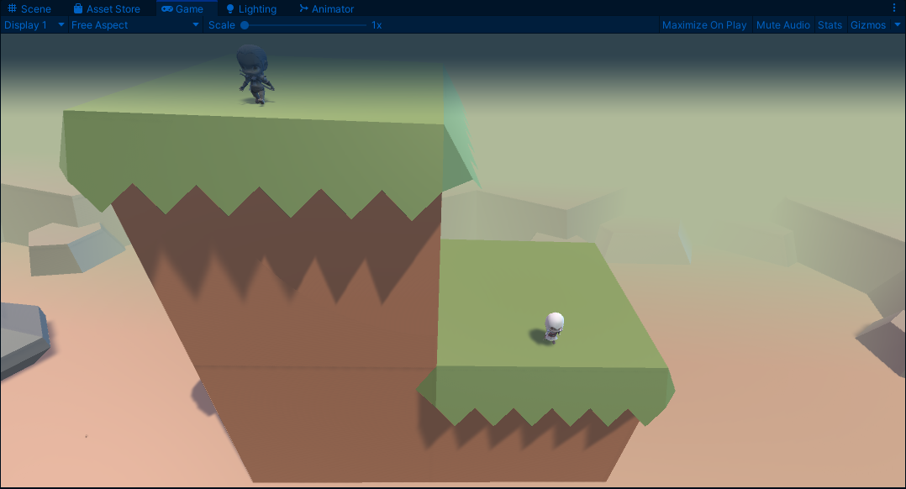
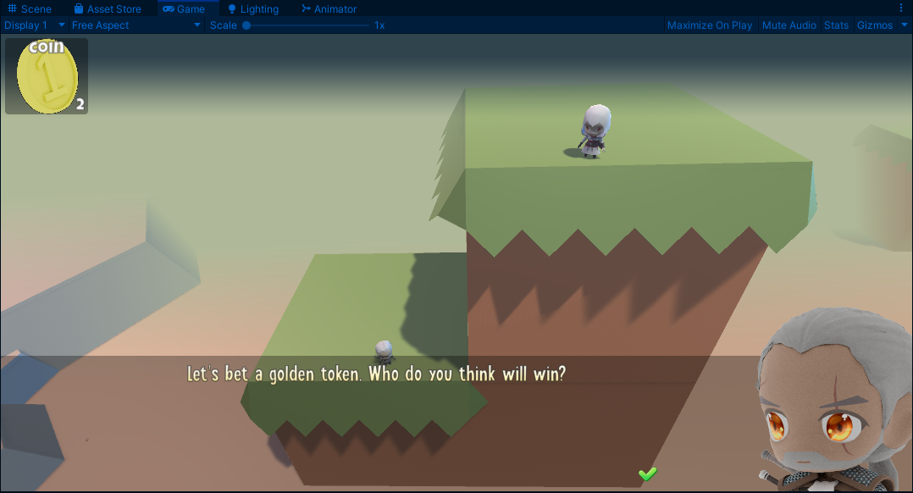
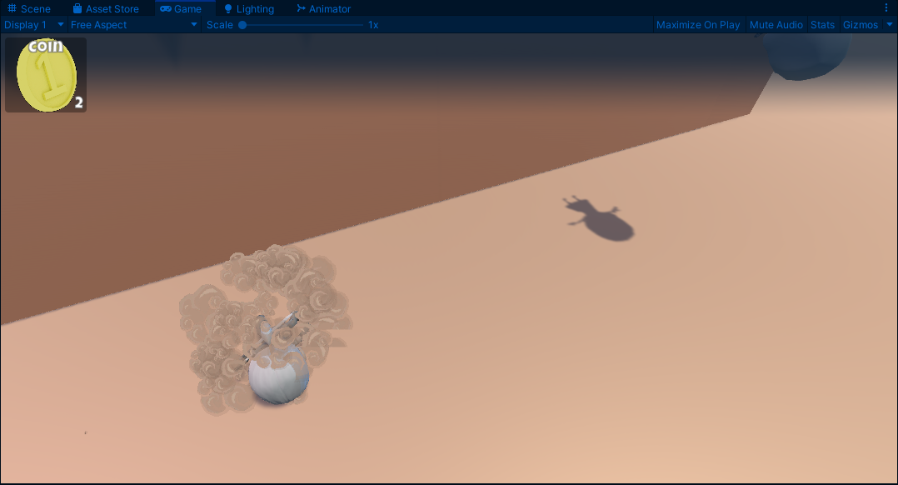
Location 3 real gameplay screens

Slide 10
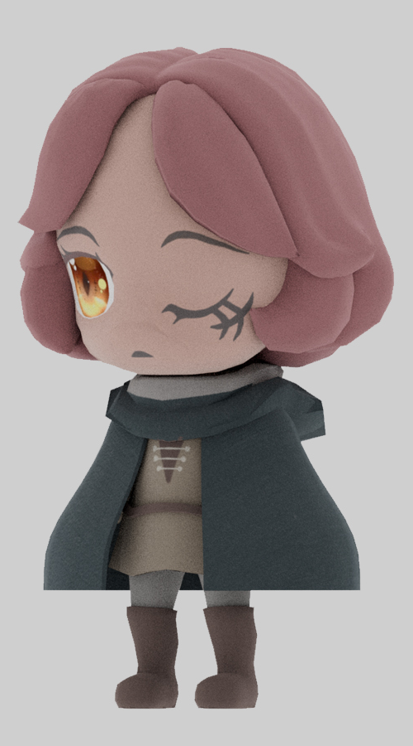
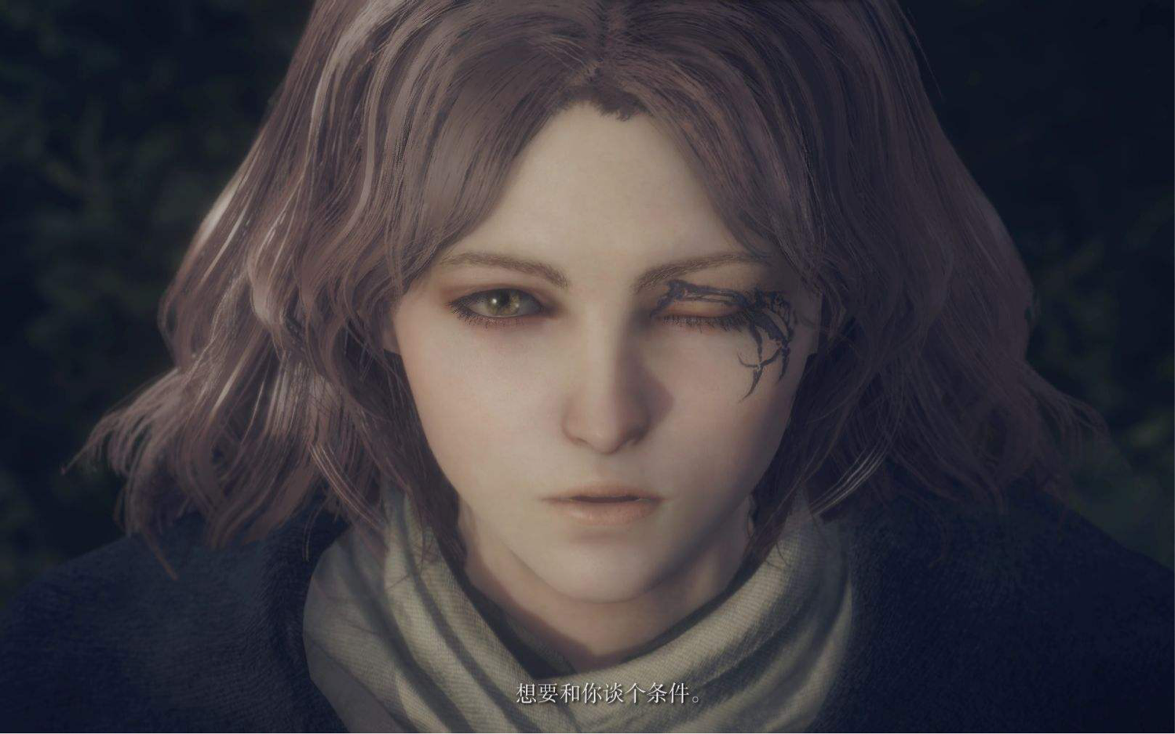
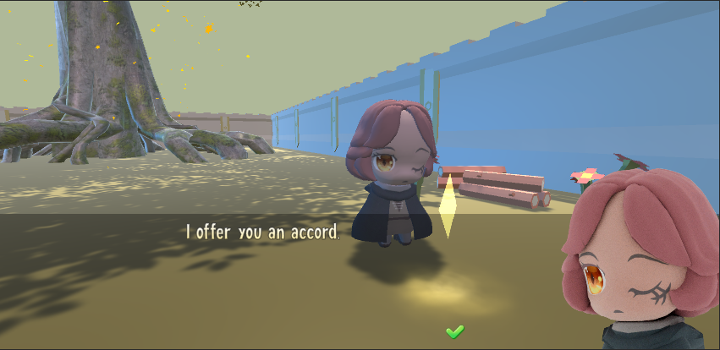
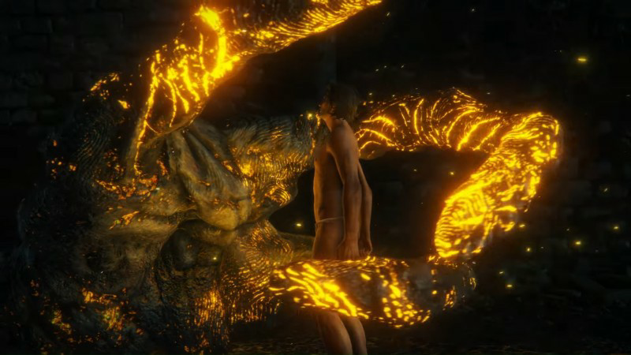
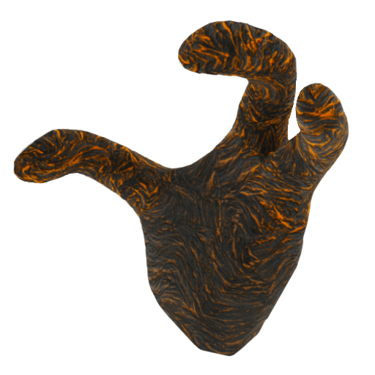
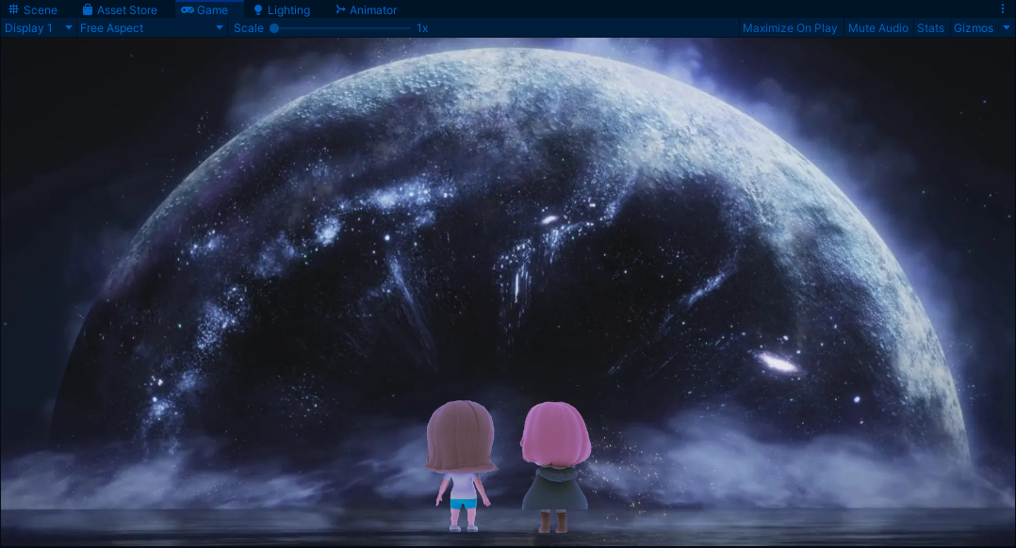
Location: The lands between
The player becomes a tarnished in Elden Ring and meets a woman who calls herself Melina. She will entrust players to help her burn the Erdtree. The player can choose to let herself burn, or accept the blessing of three fingers and burn yourself instead of Melina. The scene simulates the location of the Erdtree - the royal city of lodel. The scene simulates the location of the Erdtree -Leyndell, Royal Capital. After burning the Erdtree, the game also came to the end.

Slide 11
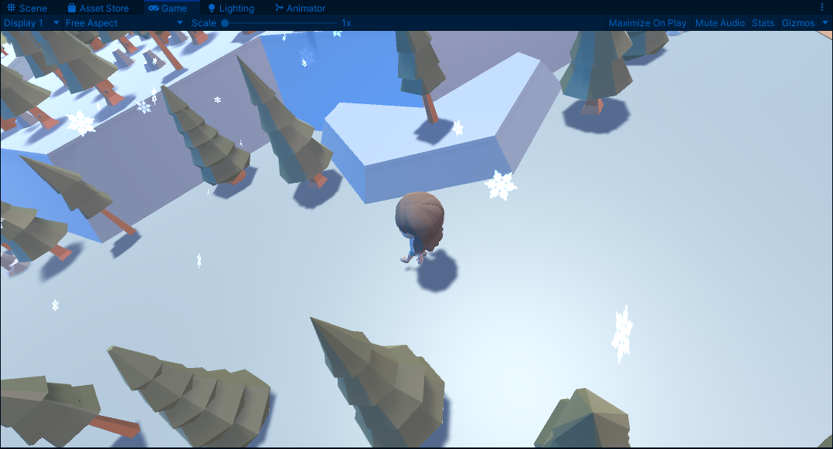
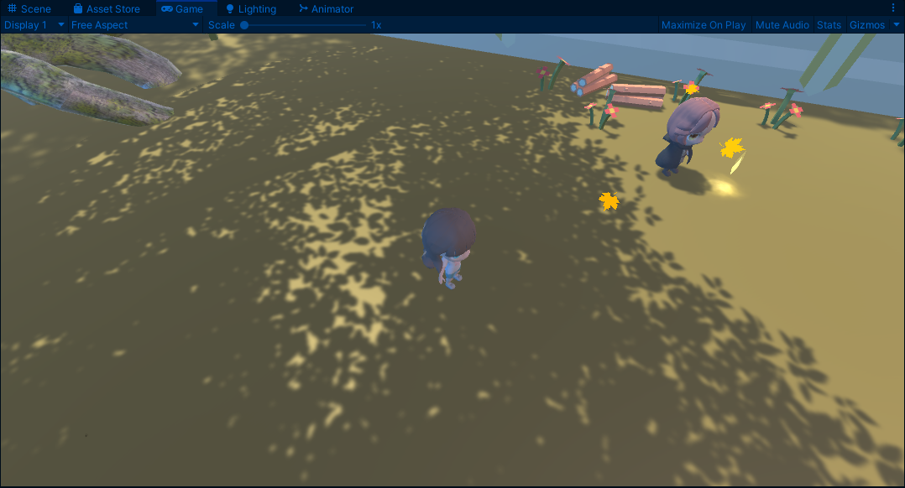
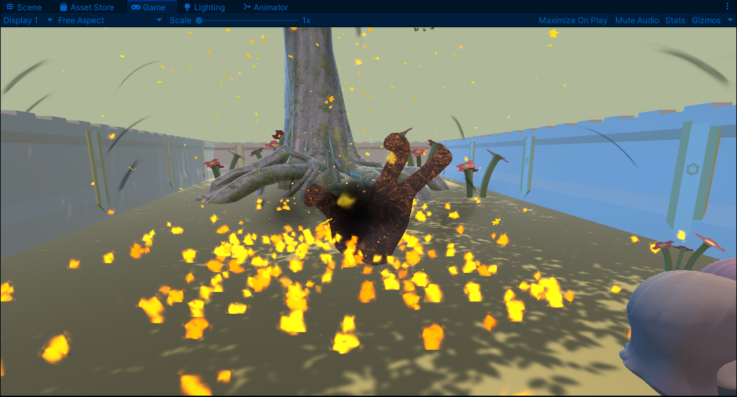
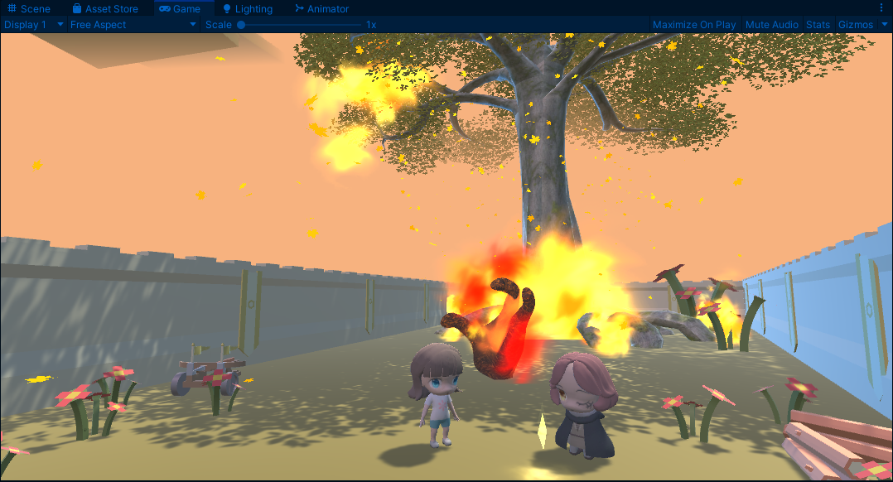
Location 4 real gameplay screens

